Slide 1


SQL DATA ANALYSIS PROJECT: JENSON USA
PRESENTED BY: SYED IBRAHIM

Slide 2


About Jenson USA :
Jenson USA is a leading retailer of high-performance bicycles, cycling accessories, and outdoor gear. Based in Riverside, California, the company offers a wide range of products, including mountain bikes, road bikes, components, and cycling apparel, catering to both amateur and professional cyclists.
With a strong e-commerce platform and multiple retail locations, Jenson USA delivers excellent customer service, expert advice, and fast shipping to customers across the United States and internationally. The company is committed to providing quality products at competitive prices, ensuring an exceptional shopping experience for cycling enthusiasts.
Jenson USA continues to innovate and adapt to the evolving cycling market, maintaining a focus on operational efficiency and customer satisfaction.

Slide 3


problem statement :
Find the total number of products sold by each store along with the store name.
Calculate the cumulative sum of quantities sold for each product over time.
Find the product with the highest total sales (quantity * price) for each category.
Find the customer who spent the most money on orders.
Find the highest-priced product for each category name.
Find the total number of orders placed by each customer per store.
Find the names of staff members who have not made any sales.
Find the top 3 most sold products in terms of quantity.
Find the median value of the price list.
List all products that have never been ordered.(use Exists)
List the names of staff members who have made more sales than the average number of sales by all staff members.
Identify the customers who have ordered all types of products (i.e., from every category).

Slide 4
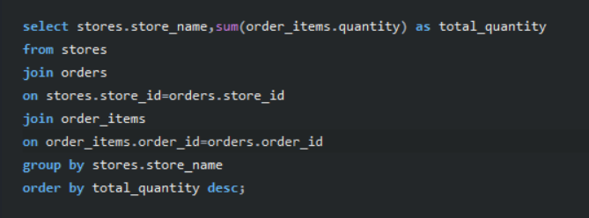


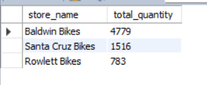
Find the total number of products sold by each store along with the store name

Slide 5

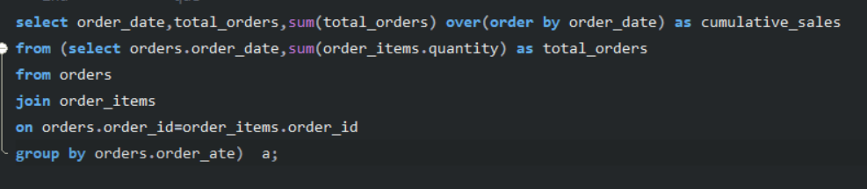
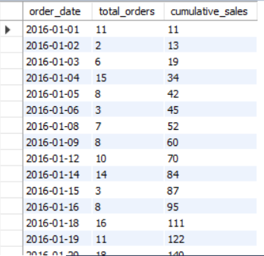
Calculate the cumulative sum of quantities sold for each product over time.

Slide 6

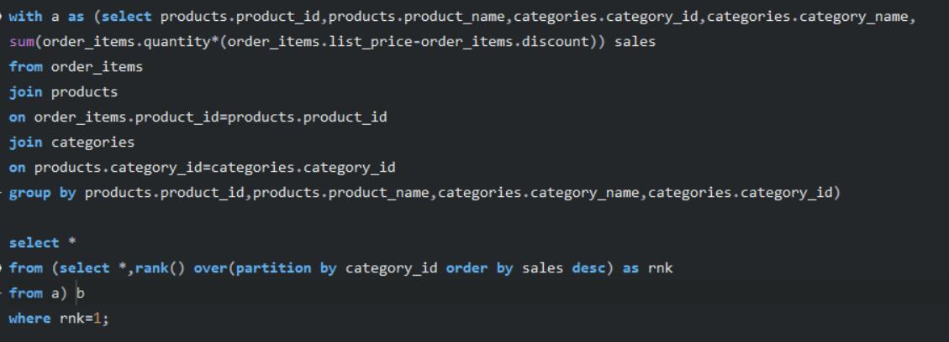
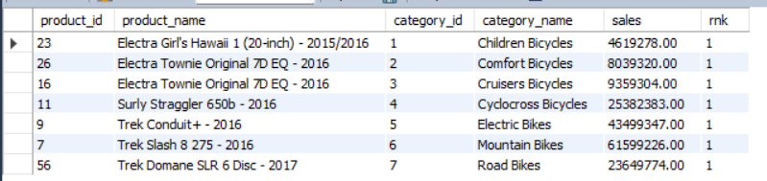
Find the product with the highest total sales (quantity * price) for each category.

Slide 7
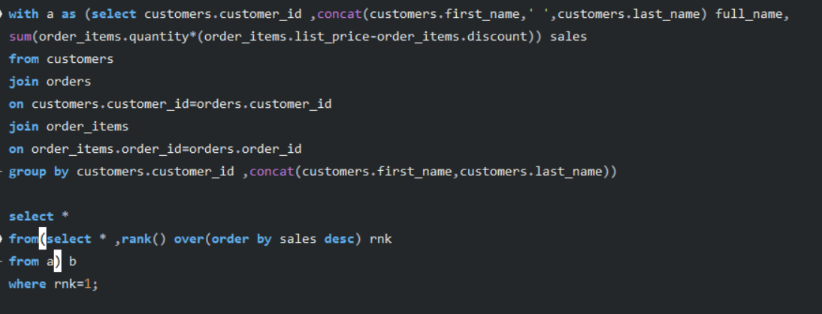

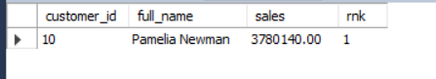
Find the customer who spent the most money on orders.

Slide 8


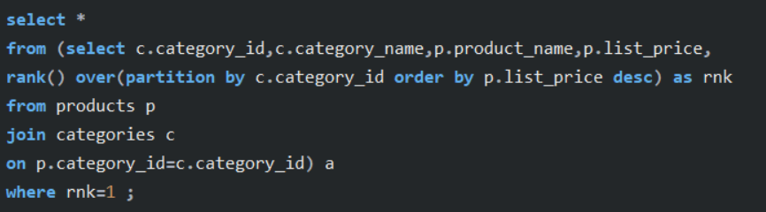
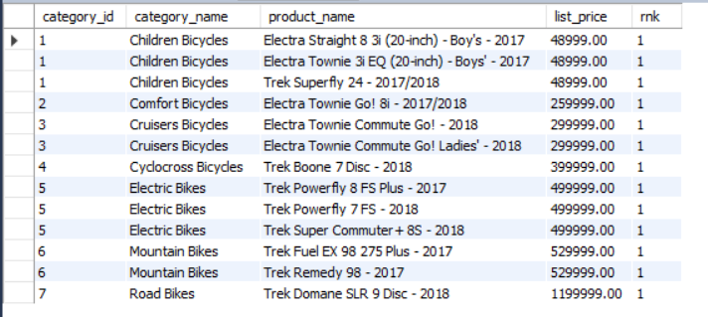

Find the highest-priced product for each category name

Slide 9


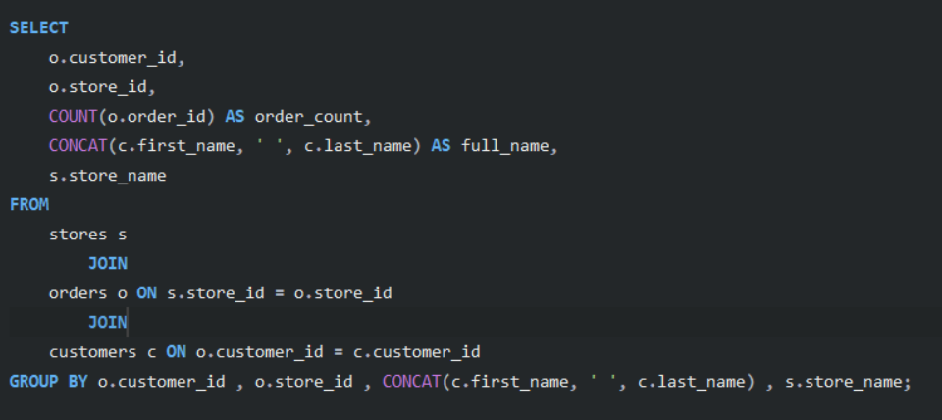

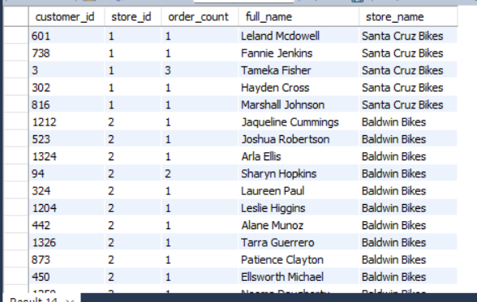
Find the total number of orders placed by each customer per store

Slide 10



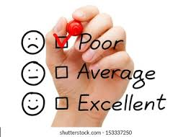


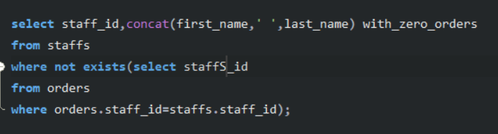

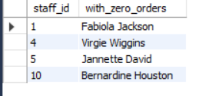
Find the names of staff members who have not made any sales

Slide 11


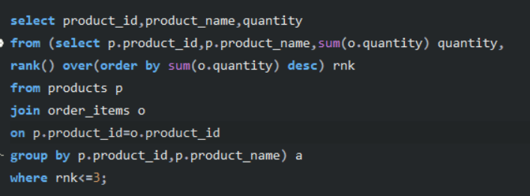
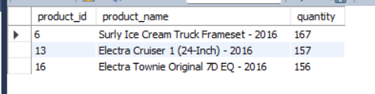
Find the top 3 most sold products in terms of quantity.

Slide 12

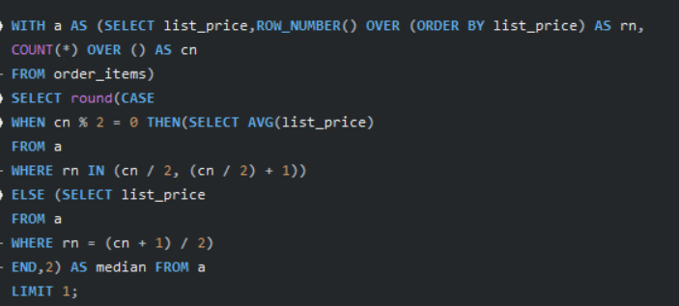
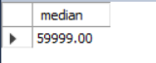
Find the median value of the price list.

Slide 13


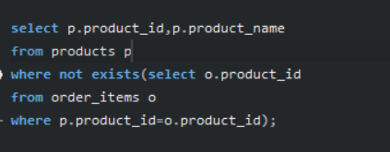
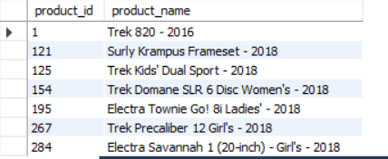
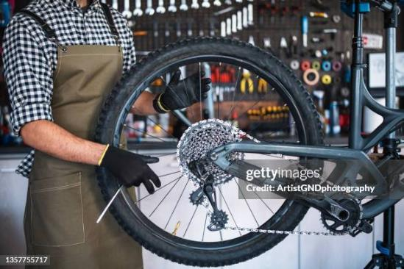
List all products that have never been ordered.(use Exists)

Slide 14

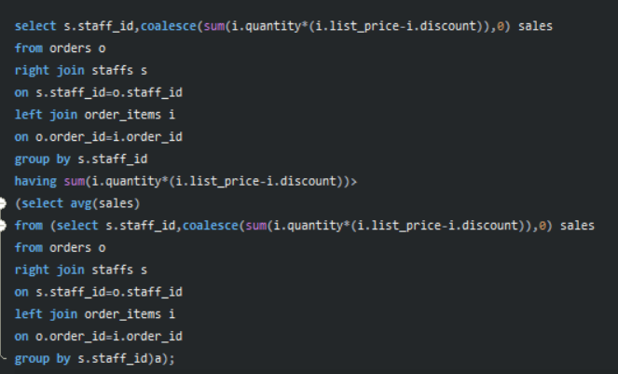
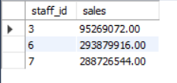
List the names of staff members who have made more sales than the average number of sales by all staff members.

Slide 15

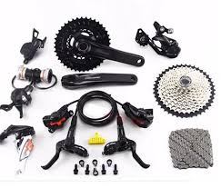
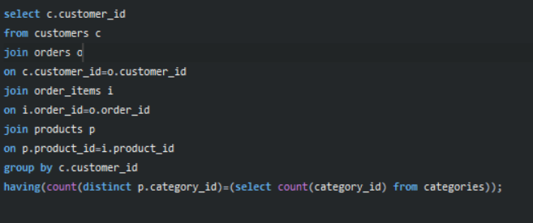
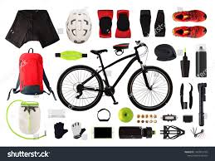


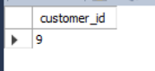
Identify the customers who have ordered all types of products (i.e., from every category).

Slide 16

Insights and Analysis :
This project utilized SQL queries to derive actionable insights from Jenson USA's data, focusing on critical areas such as store performance, sales trends, customer behavior, and staff performance. The following points summarize the key findings and their business implications:
1. Store Performance and Product Sales
Key Insight: By calculating the total quantity sold per store, we identified top-performing stores. This insight helps optimize inventory distribution and tailor marketing strategies to each store's performance.
Implication: Jenson USA can adjust stock levels based on store performance, ensuring high-demand products are readily available in key locations.
2. Top-Selling Products and Categories
Key Insight: Using RANK() and SUM() OVER(), we identified the top-selling products within each category. These insights are crucial for prioritizing stock replenishment and targeting products that drive revenue.
Implication: Jenson USA can focus on promoting top products and adjust pricing strategies based on category performance, ensuring a competitive edge in the market.

Slide 17
3. Customer Spending Behavior
Key Insight: We identified the high-value customers by analyzing total spending, and also found customers who ordered across multiple product categories.
Implication: Jenson USA can use these insights to develop targeted loyalty programs and personalized promotions, enhancing customer retention and boosting sales.
4. Staff Performance
Key Insight: By identifying top-performing staff and those who made fewer sales, we uncovered potential training opportunities.
Implication: Jenson USA can allocate resources effectively, reward top performers, and improve overall staff productivity through focused training and performance strategies.
5. Inventory Management
Key Insight: The analysis identified products that have never been ordered, flagging potential overstock or underperforming items. Additionally, by evaluating the highest-priced products in each category, we provided insights into effective pricing strategies.
Implication: Jenson USA can optimize inventory levels by discontinuing low-demand products and focusing on the most profitable items. Pricing adjustments can be made to ensure competitiveness while maintaining profitability.

Slide 18
Conclusion
The SQL-based analysis of Jenson USA's data provides actionable insights into various aspects of the business. By applying these insights, Jenson USA can make data-driven decisions that directly impact its inventory management, sales optimization, customer engagement, and staff productivity.
Through better inventory management, targeting high-value customers, and refining sales strategies, Jenson USA can not only improve its operational efficiency but also enhance the customer experience, resulting in greater customer loyalty, increased revenue, and competitive advantage in the market.
Incorporating advanced SQL functions like window functions and aggregate calculations into the analysis process enables Jenson USA to make more precise and strategic decisions. These insights will help the company optimize resources, boost profitability, and ultimately achieve its long-term growth objectives in the competitive cycling retail market.
PRESENTED BY: SYED IBRAHIM

Slide 19






PRESENTED BY: SYED IBRAHIM
THANK YOU !
Contact me
social
Mail
syedibrahim7659@gmail.com
syed ibrahim

